Slide 1
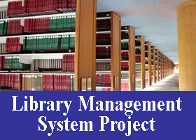
Library management system

Slide 2

Team members:
Presented by:
B. Snehal kumar
Rasala Sathish
Puli shravan kumar
Belgewar Sunil
Madgula Gayathri

Slide 3
Introduction:
Library management system is a project which aims in developing computerized system to maintain all the daily work of library.
It has the facility of admin login through which admin can monitor the whole system.
Admin modules are add new book, view books, issue book and return book.
Overall this project of ours is being developed to help the library administration , maintain the library in the best way possible and also reduce the human efforts.

Slide 4
Objective:
The main objective of library management system is to manage the details of books, students , book issue and return book.
It manages all the information about book issue and return .
develop an online system to help the users(librarian’s).
To manage the distribution and collection books.
To track the records and to modify

Slide 5
Purpose:
The purpose of library management system is to automate the existing system by the help of computerized equipment and full fledged computer software, fulfilling their requirements,
so that their Valuable data/information can be stored for a longer period with easy accessing and manipulation of the same.
This project also helps in administrative work such as keep information of book issue and return.

Slide 6
Requirements:
Windows version 7+
Front end Software: Html , CSS , java script.
Backend software: Java, Spring Boot, Spring Data JPA, Spring Security, Database.

Slide 7
Project scope:
Our project aims to safe and easy handling of library. i.e. we have made a computerized process to store data and distribution.
It satisfies the admin(librarian).
It is easy and safe to store data.
It is easy to operator.
Have a good user interface.
It saves time and function faster.
It helps the Librarian to handle the library.
We have tried to develop safe and secure software with above mentioned specifications.
Scope of change: barcoding reading.

Slide 8


Used Tools and technologies:
Frontend: Html and CSS.
Back end: Spring tool suite
MySQL Database.
Online tools:
Word pad
Notepad

Slide 9
Proposed system:
The library management system is available in the market that can serve librarians in schools and colleges to manage book issue and book return.

Slide 10
Modules:
We have admin module along with that we have some other modules:
Student info!.
Add book.
Add student.
Issue book.
Return book.
All records.
Fine payment.
Search book.

Slide 11

Frontend [language used]:
Java(Swing)

Slide 12


Backend [language used]:
My SQL

Slide 13
Software used:
JDK (Java development kit
MY SQL

Slide 14
Data flow diagram:
Login
Admin
Home Page
Return Book
Add Student
Issue Book
Add Book
Student Info.
Book Info.
Search
Fine Payment
All Records.
Book ID
Book Title
Reg. Number
Student Name

Slide 15
Use case diagram:
A use case depicts a series of steps that give something significant value to an actor and is drawn as a horizontal ellipse.
A use case diagram apprehends the functional features of a system with processes implement in the system.
While discussing the functionality and procedures of the framework,
you discover important characteristics of the framework that you represent in the use case diagram

Slide 16
Use Case diagram:

Slide 17
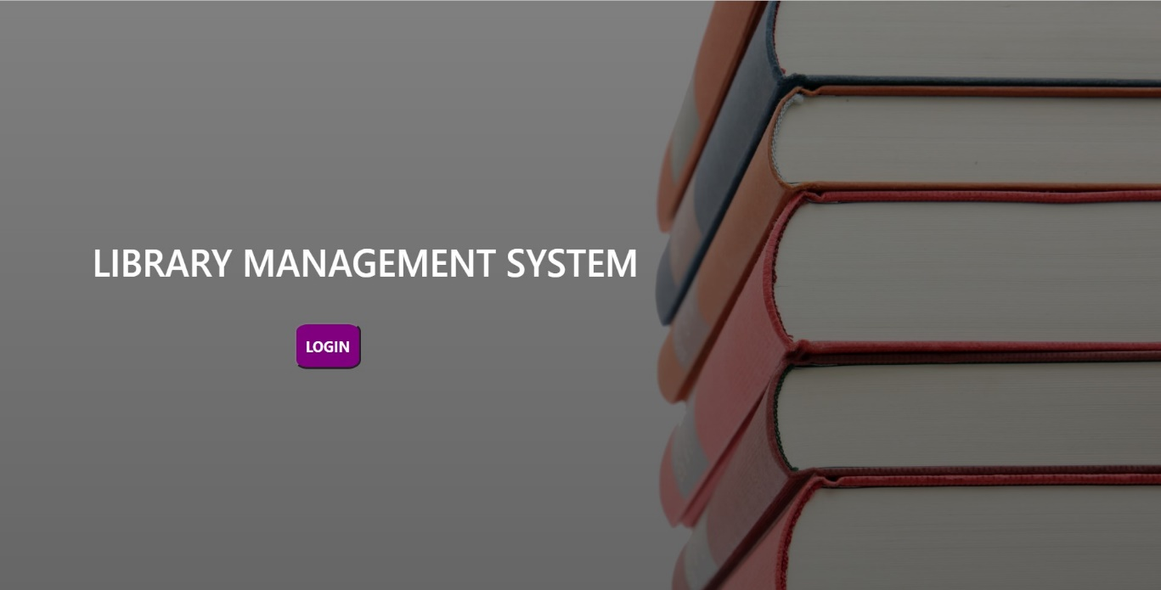
Login page:

Slide 18
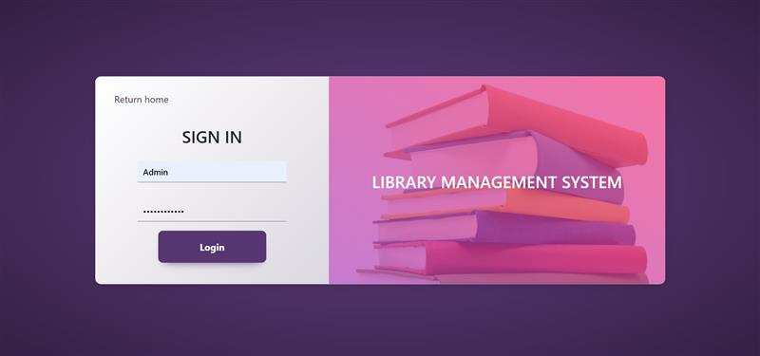
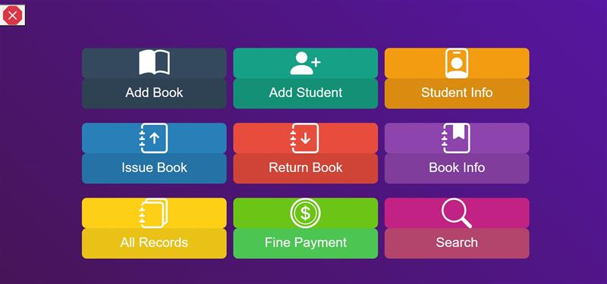
Home page:

Slide 19
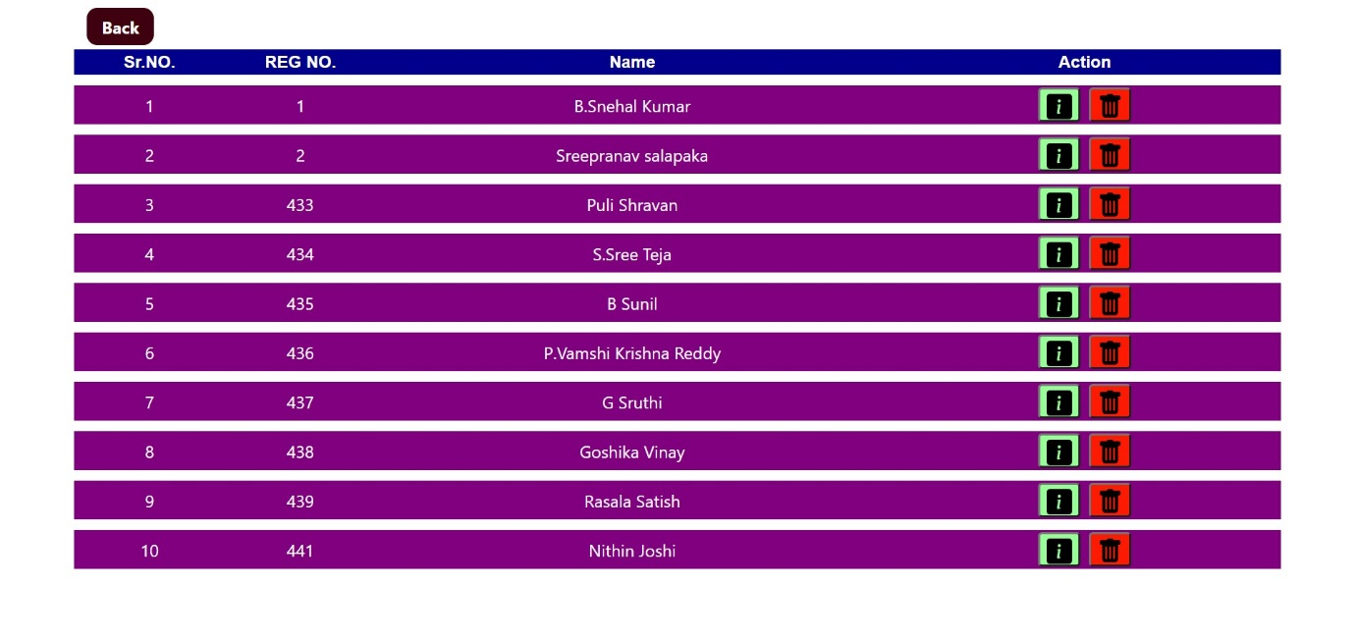
Student info!

Slide 20
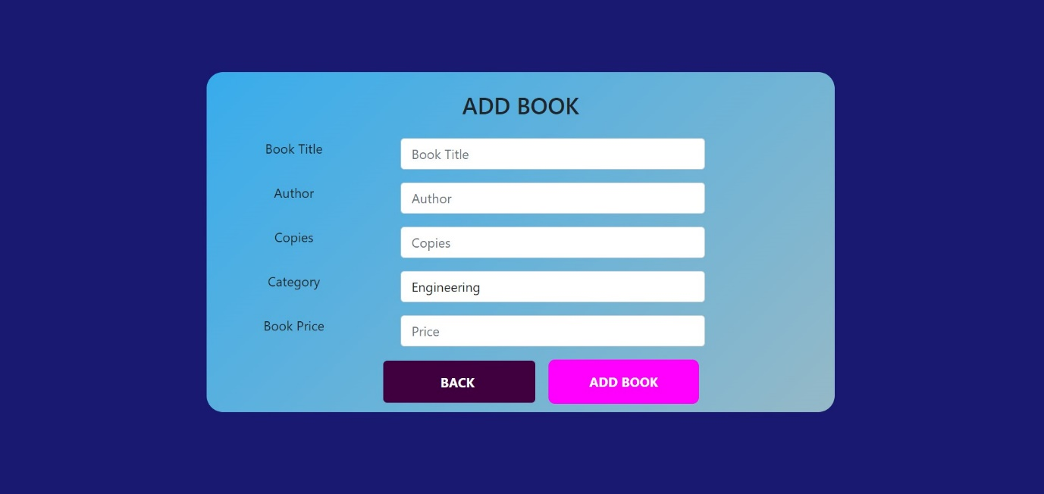
Add book:

Slide 21
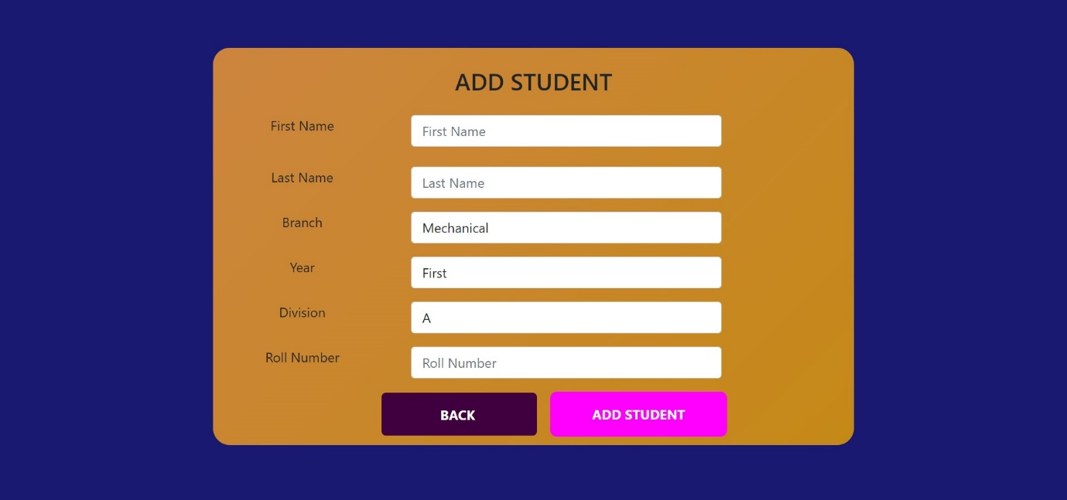
Add student:

Slide 22
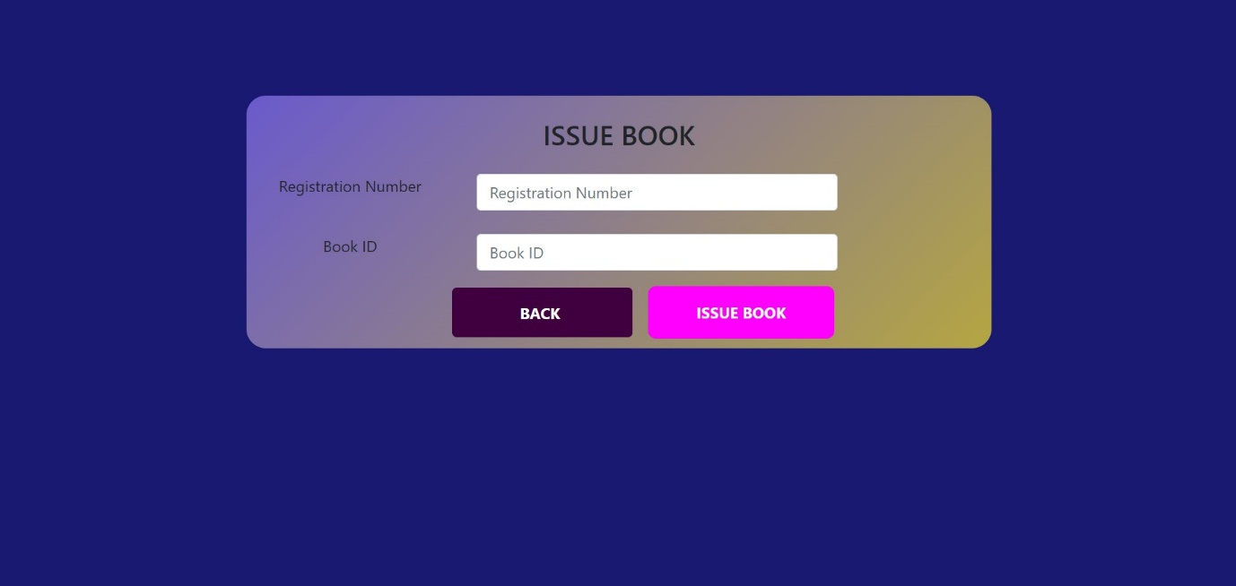
Issue book:

Slide 23
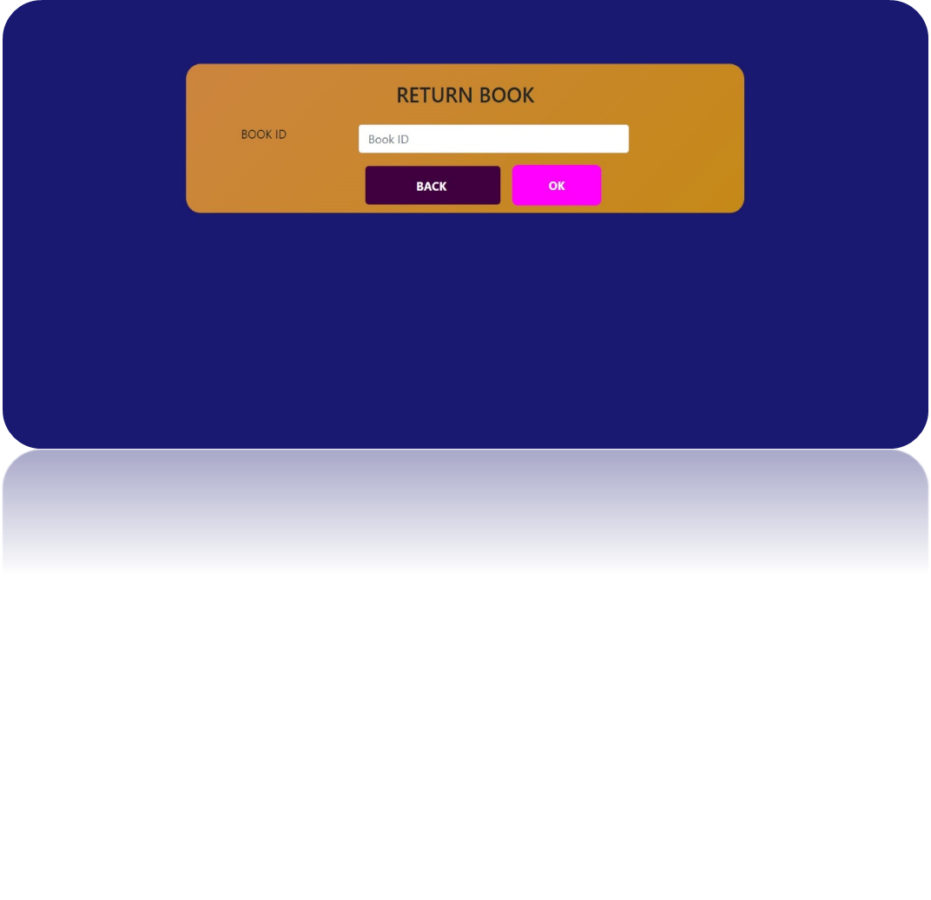
Return book:

Slide 24
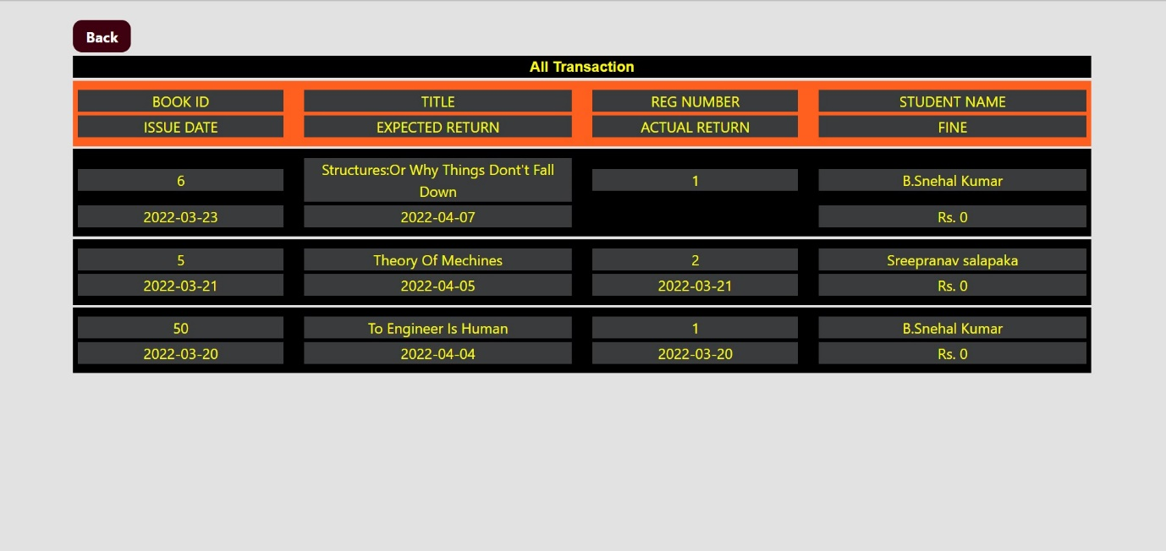
All records:

Slide 25
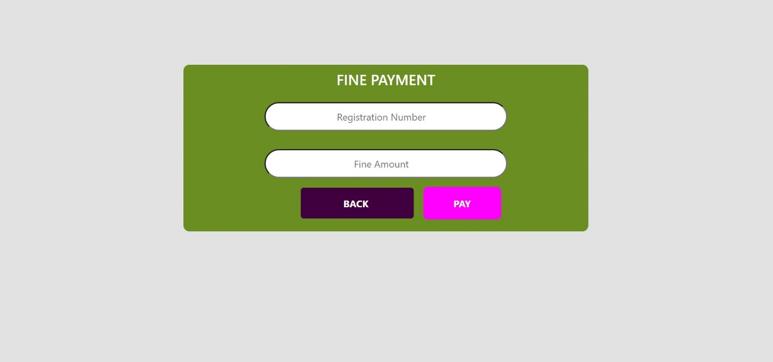
Fine payment:

Slide 26
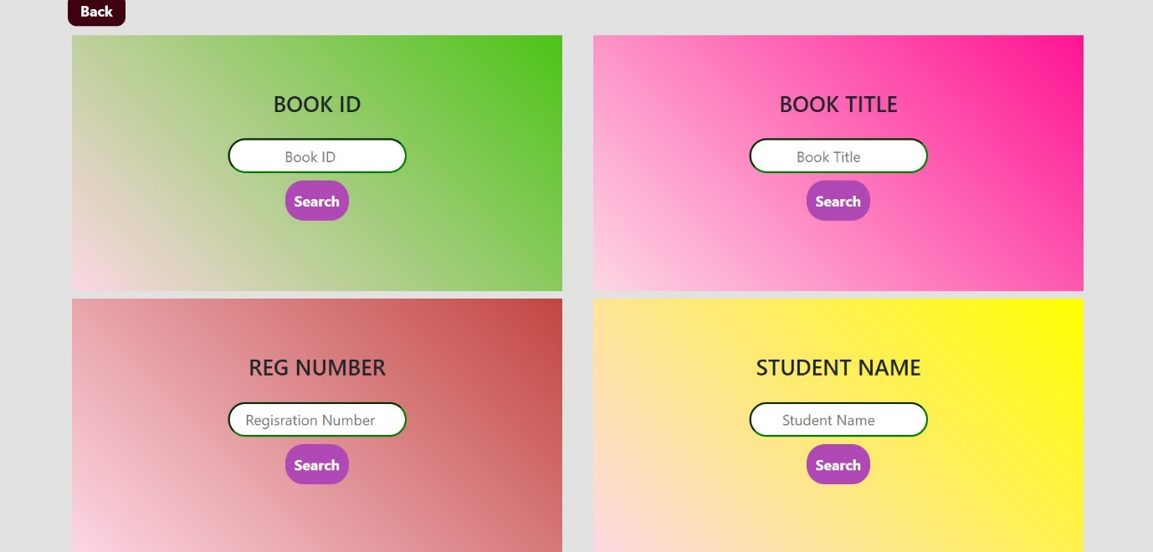
Search book:

Slide 27
Conclusion and future scope:
Future scope:
This application involves almost all the basic features of library management.
The future implementation will be help for the students.
Conclusion:
the project entitled “library management system” is developed using java swing as frontend and MySQL database in backend to computerize the process of online management of books, issued and returned books. This projects covers only the basic features required.

